Slide 1
Basics of Diffraction through Apertures
Aug. 26, 2022

Slide 2
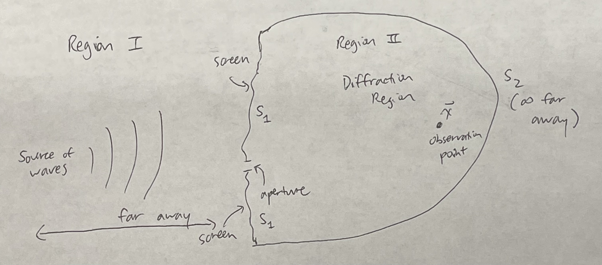
Introduction to Diffraction Theory (from Jackson Ch. 10.5)
Diffraction = departure from geometrical optics (ray tracing and 𝜆 → 0 limit) due to finite 𝜆 of waves. Typically involves how waves interact w/obstacles (such as apertures).
Here, provide a general derivation of an approximate analytical expression for the diffracted field. This is (most commonly) known as the Kirchhoff diffraction theory.
The basic setup is below:

Slide 3
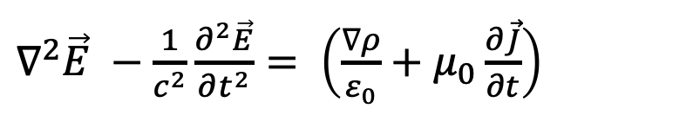
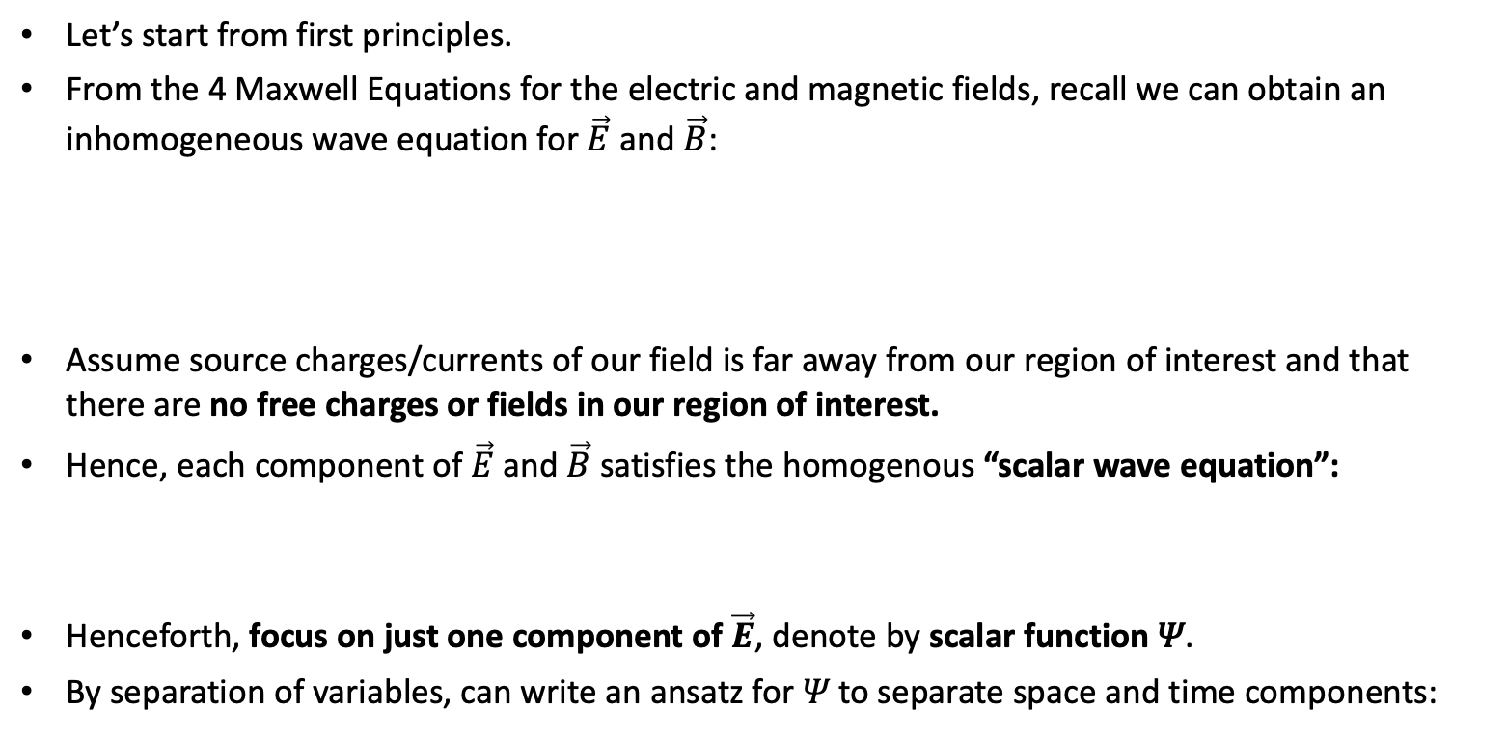
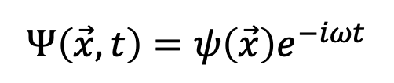
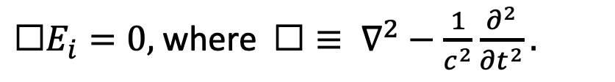
Preliminaries
Let’s start from first principles.
From the 4 Maxwell Equations for the electric and magnetic fields, recall we can obtain an inhomogeneous wave equation for $\vec{E}$ and $\vec{B}$:
Assume source charges/currents of our field is far away from our region of interest and that there are no free charges or fields in our region of interest.
Hence, each component of $\vec{E}$ and $\vec{B}$ satisfies the homogenous “scalar wave equation”:
Henceforth, focus on just one component of $\vec{E}$, denote by scalar function 𝛹.
By separation of variables, can write an ansatz for 𝛹 to separate space and time components:
$∇^{2}\vec{E} −\frac{1}{c^{2}}\frac{∂^{2}\vec{E}}{∂t^{2}}= \left(\frac{∇ρ}{ε_{0}}+μ_{0}\frac{∂\vec{J}}{∂t}\right)$
$☐E_{i}=0,$ where $☐≡ ∇^{2}−\frac{1}{c^{2}}\frac{∂^{2}}{∂t^{2}}.$
$$Ψ\left(\vec{x},t\right)=ψ\left(\vec{x}\right)e^{−iωt}$$

Slide 4
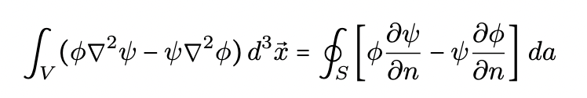
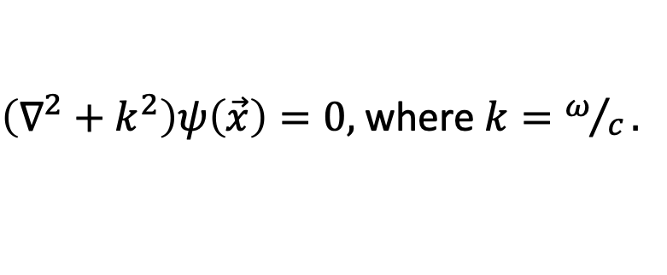
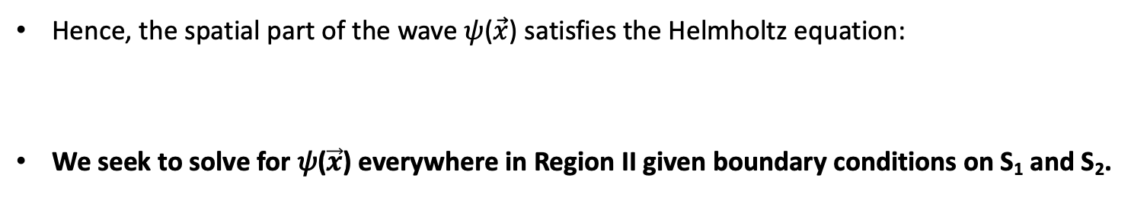
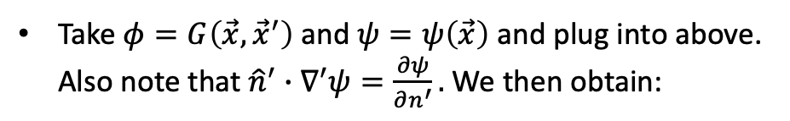
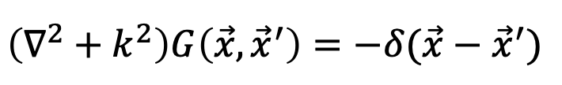
Solving the Helmholtz equation w/Green’s Theorem
Hence, the spatial part of the wave 𝜓($\vec{x}$) satisfies the Helmholtz equation:
We seek to solve for 𝜓($\vec{x}$) everywhere in Region II given boundary conditions on S₁ and S₂.
$\left(∇^{2}+k^{2}\right)ψ\left(\vec{x}\right)=0,$ where $k=ω/c.$
Do this using the Green’s function and Green’s theorem.
Green’s function for Helmholtz equation satisfies:
$$\left(∇^{2}+k^{2}\right)G\left(\vec{x},{\vec{x}}^{′}\right)=−δ(\vec{x}−{\vec{x}}^{′})$$
Green’s theorem expresses scalar field inside a volume V in terms of values of the field and its normal derivative on boundary surface S:
Take $φ=G\left(\vec{x},{\vec{x}}^{′}\right)$ and $ψ=ψ\left(\vec{x}\right)$ and plug into above. Also note that ${\hat{n}}^{′}∙∇^{′}ψ=\frac{∂ψ}{∂n^{′}}.$ We then obtain:

Slide 5
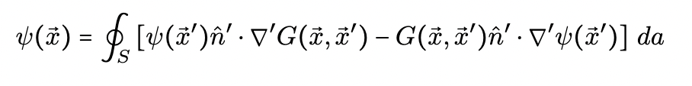
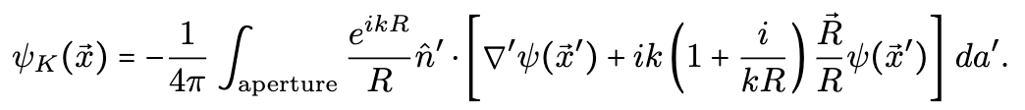
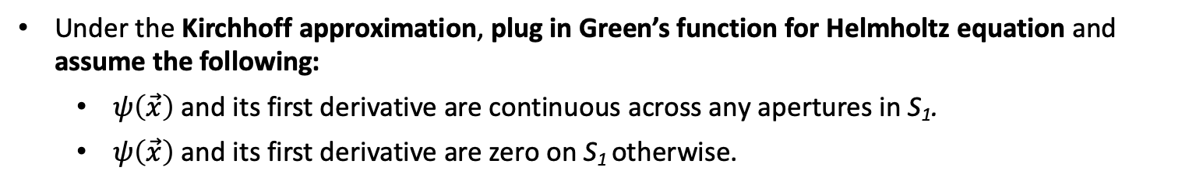
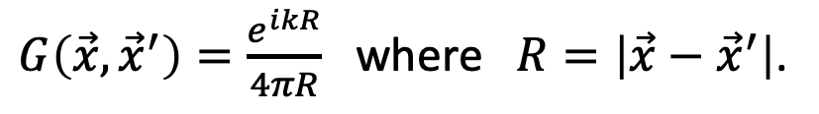
Obtaining the Kirchhoff Diffraction Integral
Note: assume inward pointing unit normal.
Under the Kirchhoff approximation, plug in Green’s function for Helmholtz equation and assume the following:
$ψ\left(\vec{x}\right)$ and its first derivative are continuous across any apertures in S₁.
$ψ\left(\vec{x}\right)$ and its first derivative are zero on S₁ otherwise.
Green’s function for Helmholtz equation is just spherical waves (assume outgoing at infinity):
$G\left(\vec{x},{\vec{x}}^{′}\right)=\frac{e^{ikR}}{4πR}$ where $R=\left|\vec{x}−{\vec{x}}^{′}\right|$.
Upon plugging in and noting that the integral over S₂ will vanish when we take it to be infinitely far away, and same for S₁ everywhere besides aperture, we obtain the Kirchhoff diffraction integral:

Slide 6
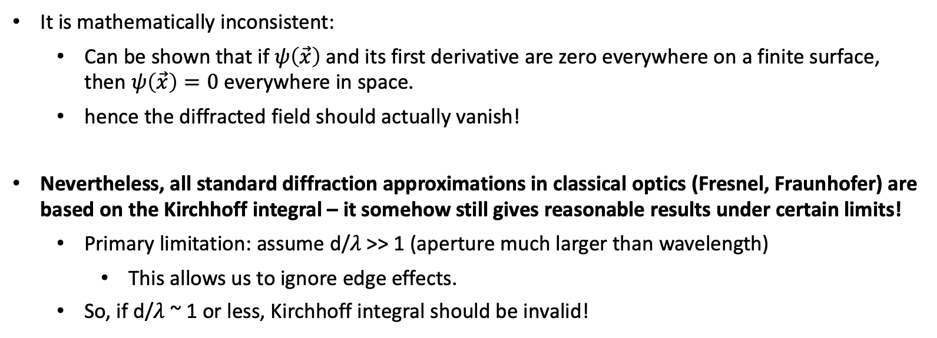
Problems with the Kirchhoff Diffraction Integral
It is mathematically inconsistent:
Can be shown that if $ψ\left(\vec{x}\right)$ and its first derivative are zero everywhere on a finite surface, then $ψ\left(\vec{x}\right)=0$ everywhere in space.
hence the diffracted field should actually vanish!
Nevertheless, all standard diffraction approximations in classical optics (Fresnel, Fraunhofer) are based on the Kirchhoff integral – it somehow still gives reasonable results under certain limits!
Primary limitation: assume d/𝜆 >> 1 (aperture much larger than wavelength)
This allows us to ignore edge effects.
So, if d/𝜆 ~ 1 or less, Kirchhoff integral should be invalid!

Slide 7
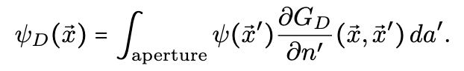
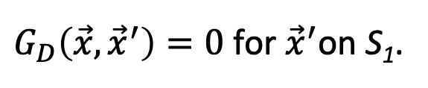
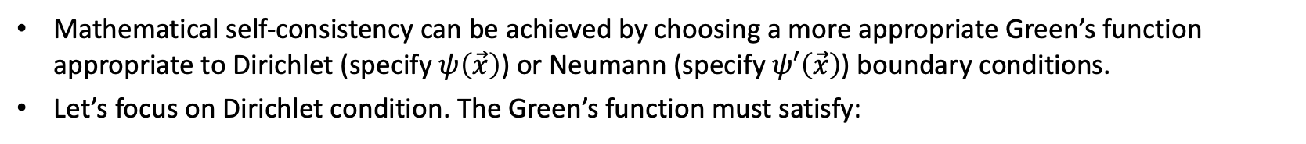
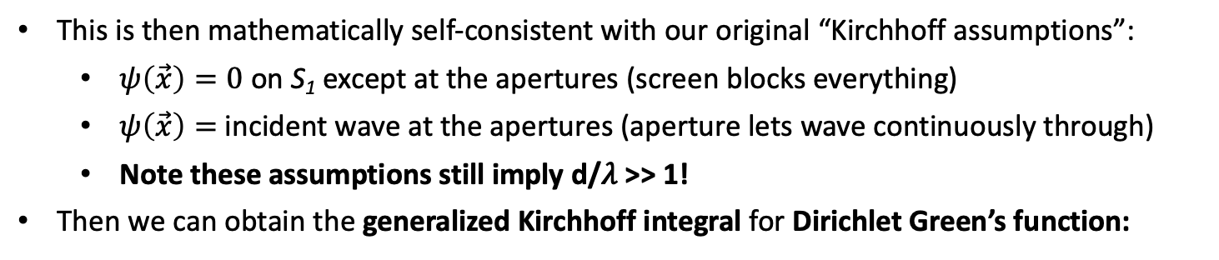
Using the Dirichlet Green’s Function Instead
Mathematical self-consistency can be achieved by choosing a more appropriate Green’s function appropriate to Dirichlet (specify $ψ\left(\vec{x}\right)$) or Neumann (specify $ψ′\left(\vec{x}\right)$) boundary conditions.
Let’s focus on Dirichlet condition. The Green’s function must satisfy:
$G_{D}\left(\vec{x},{\vec{x}}^{′}\right)=0$ for ${\vec{x}}^{′}$on S₁.
This is then mathematically self-consistent with our original “Kirchhoff assumptions”:
$ψ\left(\vec{x}\right)=0$ on S₁ except at the apertures (screen blocks everything)
$ψ\left(\vec{x}\right)=$ incident wave at the apertures (aperture lets wave continuously through)
Note these assumptions still imply d/𝜆 >> 1!
Then we can obtain the generalized Kirchhoff integral for Dirichlet Green’s function:

Slide 8
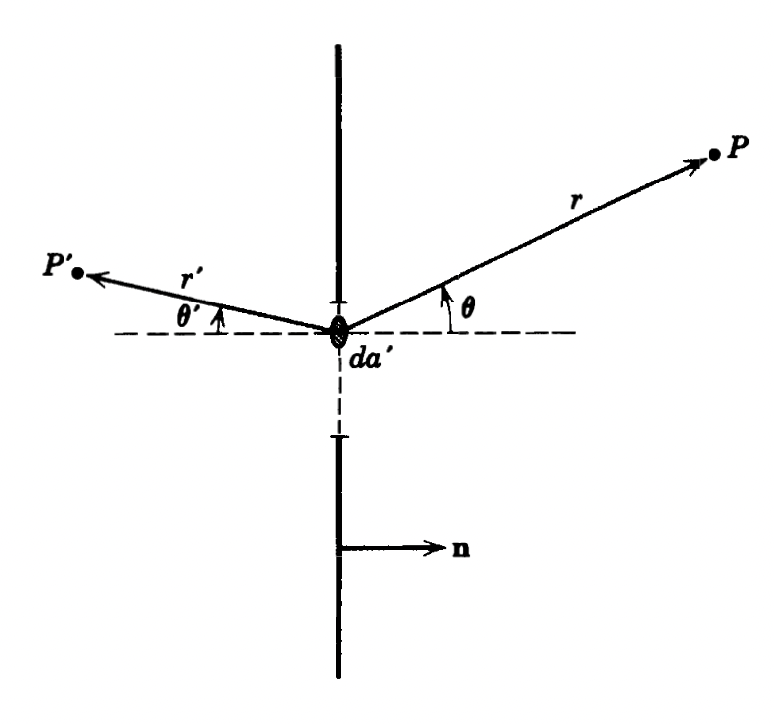
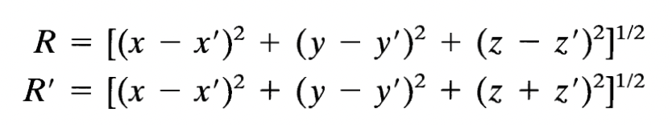
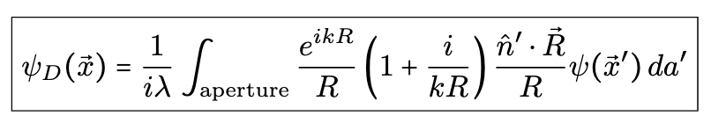
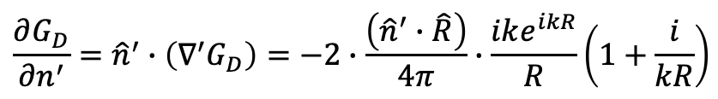
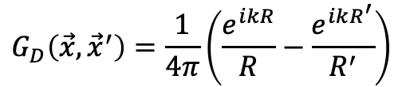
Specializing to the case of “planar screen” w/aperture at z=0
Here we can obtain more specialized integrals for the case where we have a planar screen with an aperture in it, located at z = 0. We will do this for both Dirichlet and Kirchhoff cases.
For the Dirichlet case:
screen
Method of images used to obtain the following explicit Green’s function:
observ. pt.
$$G_{D}\left(\vec{x},{\vec{x}}^{′}\right)=\frac{1}{4π}\left(\frac{e^{ikR}}{R}−\frac{e^{ikR^{′}}}{R^{′}}\right)$$
source
Hence compute generalized Kirchhoff integral:
aperture
$$\frac{∂G_{D}}{∂n^{′}}={\hat{n}}^{′}∙\left(∇^{′}G_{D}\right)=−2∙\frac{\left({\hat{n}}^{′}∙\hat{R}\right)}{4π}∙\frac{ike^{ikR}}{R}\left(1+\frac{i}{kR}\right)$$

Slide 9
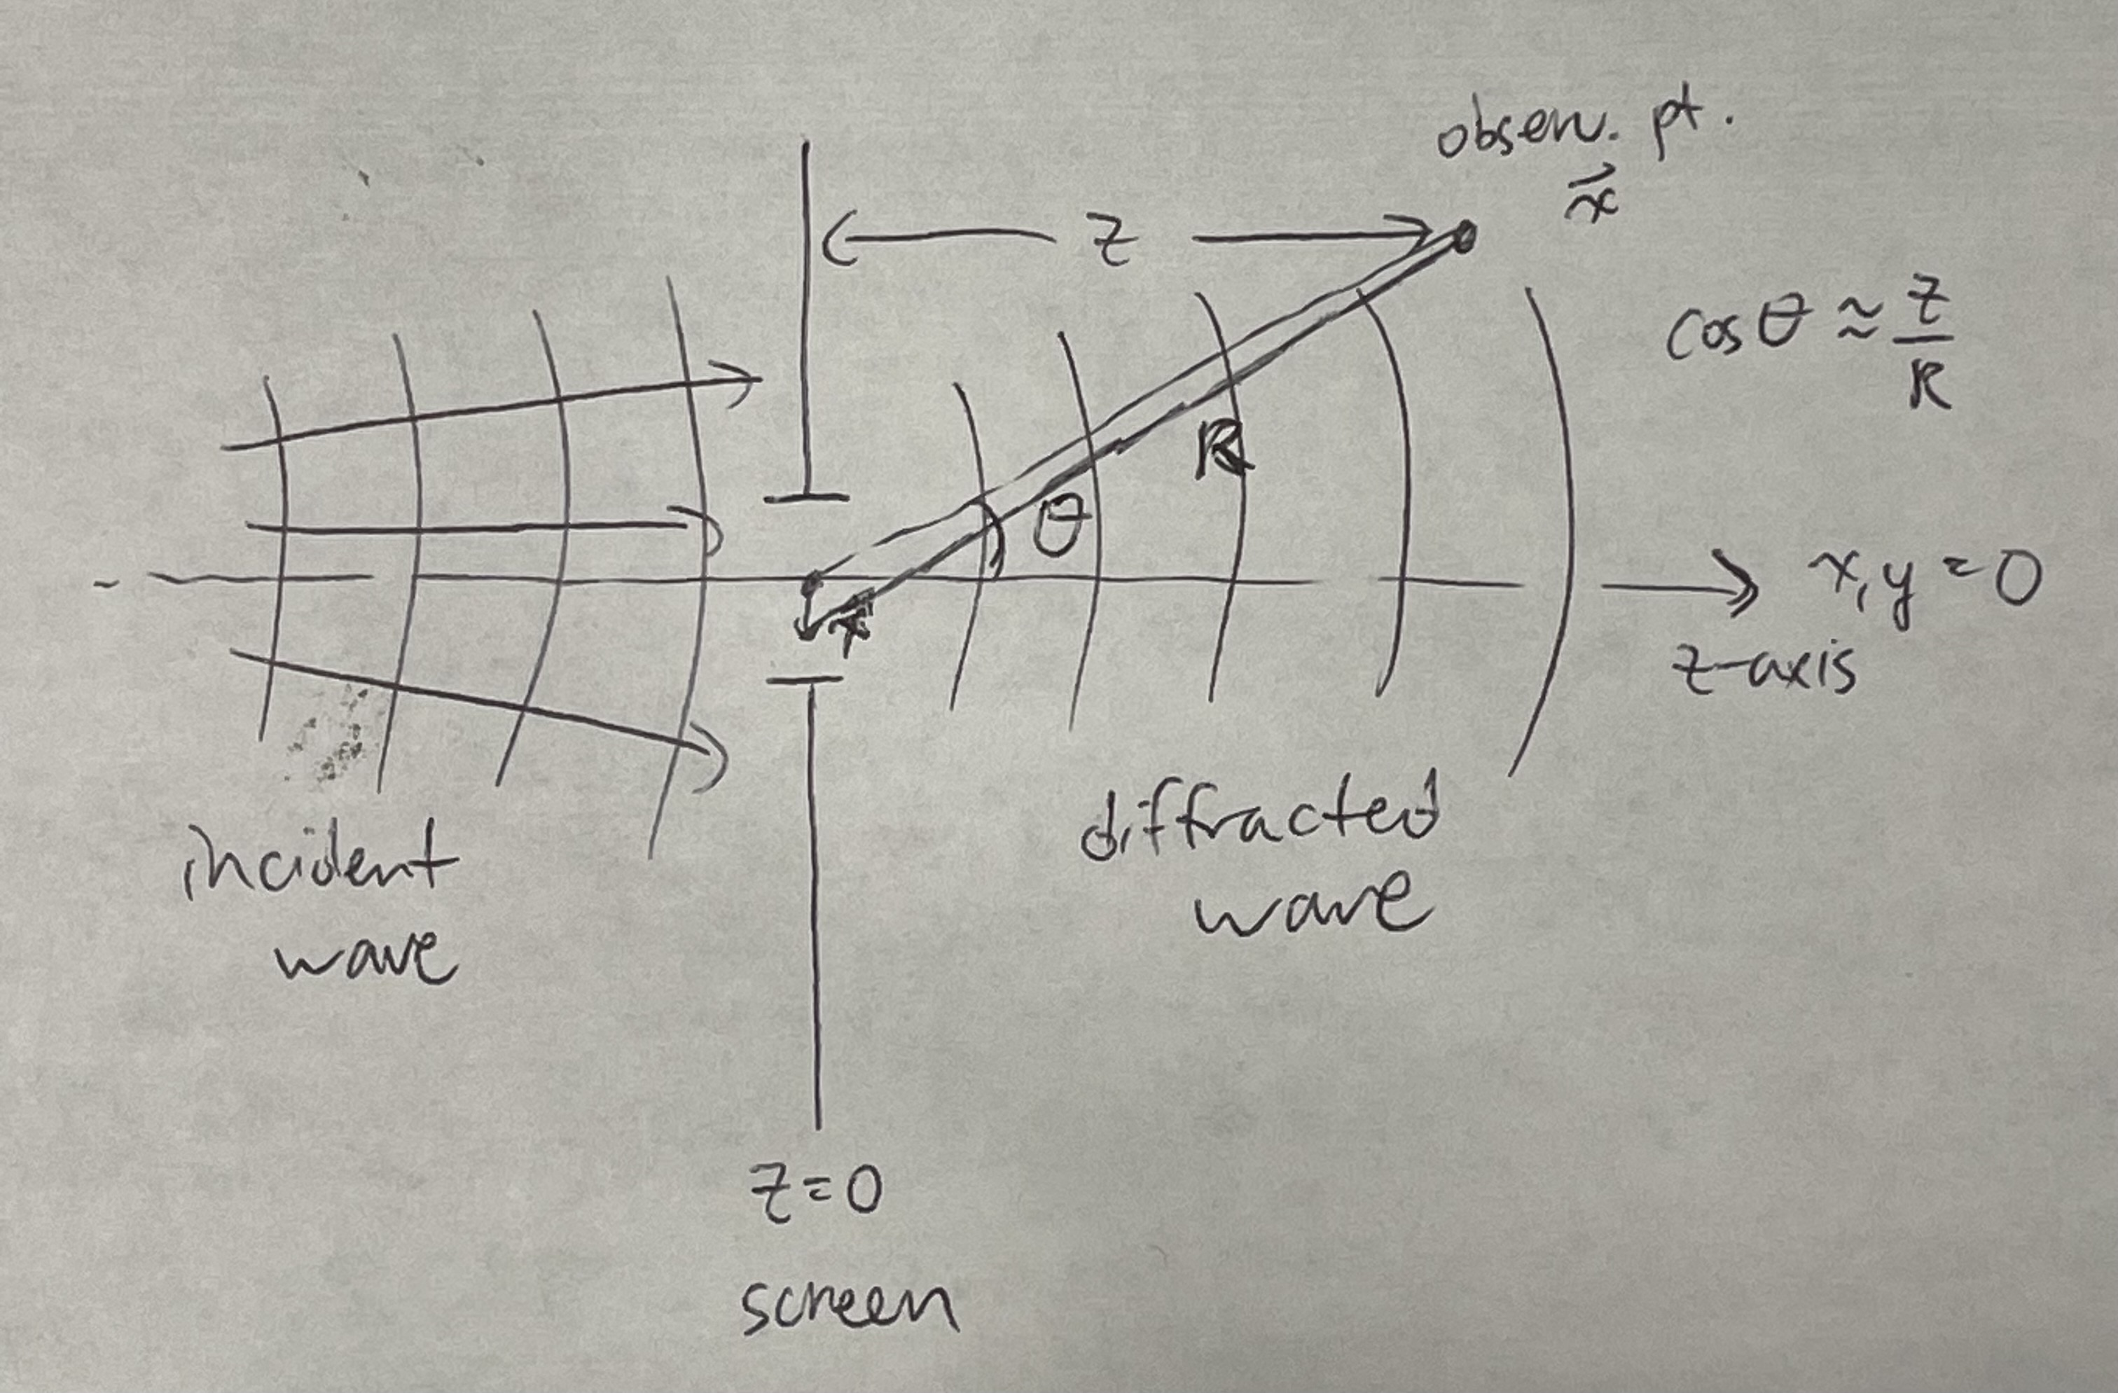
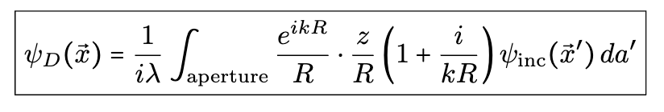
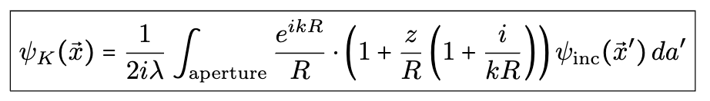
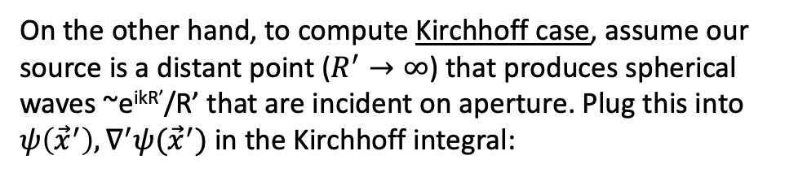
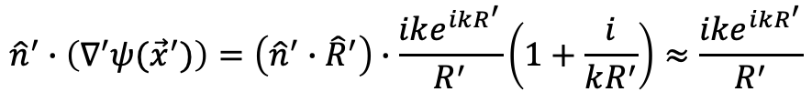
Suppose incoming waves are symmetric w.r.t. aperture axis (see figure to the right).
Can further simplify to obtain:
On the other hand, to compute Kirchhoff case, assume our source is a distant point ($R^{′}→∞$) that produces spherical waves ~e^{ikR’}/R’ that are incident on aperture. Plug this into $ψ\left({\vec{x}}^{′}\right), ∇^{′}ψ({\vec{x}}^{′})$ in the Kirchhoff integral:
$${\hat{n}}^{′}∙\left(∇^{′}ψ({\vec{x}}^{′})\right)=\left({\hat{n}}^{′}∙{\hat{R}}^{′}\right)∙\frac{ike^{ikR^{′}}}{R^{′}}\left(1+\frac{i}{kR^{′}}\right)≈\frac{ike^{ikR^{′}}}{R^{′}}$$

Slide 10
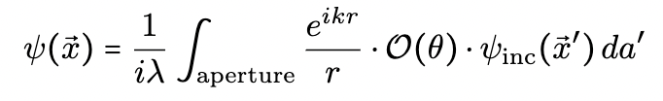
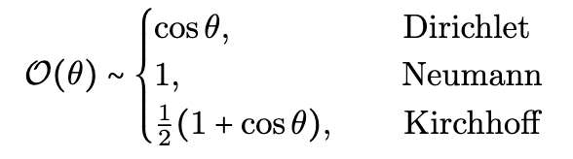
Comparison b/w Dirichlet and Kirchhoff results
Jackson states that the diffracted fields for all three approximations (Kirchhoff, Dirichlet, Neumann) can be written in this common form:
Here 𝒪(𝜃) is an “obliquity factor” that is of order unity:
All these expressions are most valid only in the limit of d/𝜆 >> 1. Expect better accuracy at further distances from aperture.
Since they’re all order unity, makes no real difference which approximation to use.

Slide 11
My Calculation
Most interested in intensity of beam at location of molecules after beam passes through hard aperture.
Assume molecules are located on aperture axis.
Use Kirchhoff integral to compute field intensity relative to unperturbed intensity at fixed distance from aperture (z = 1.0𝜆) as function of aperture diameter. (this is what [1] did).
Assumptions:
Molecular cloud extent negligible compared to wavelength
Gaussian beam waist located at z = 0.
x
z = 0
Diffracted beam afterward
z
d
Drawing not to scale.
Gaussian beam before aperture
hard aperture (RF MOT coil)
Compute field intensity relative to unperturbed intensity at specific z on axis.
[1] = Diffraction Pattern of a Circular Aperture at Short Distances, C.L. Andrews, Phys. Rev. Vol. 71 No. 11, pgs. 777-786 (1947).

Slide 12
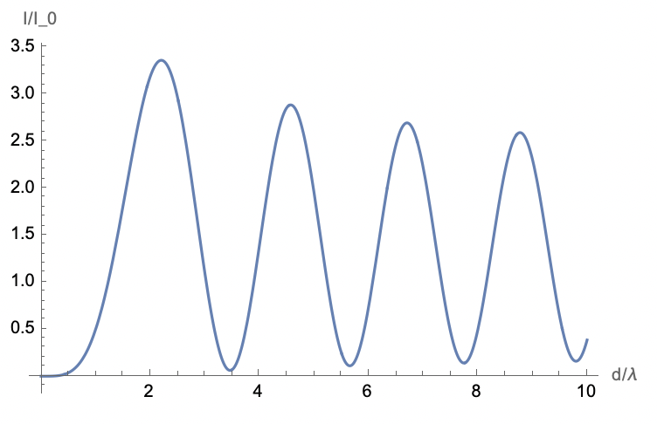
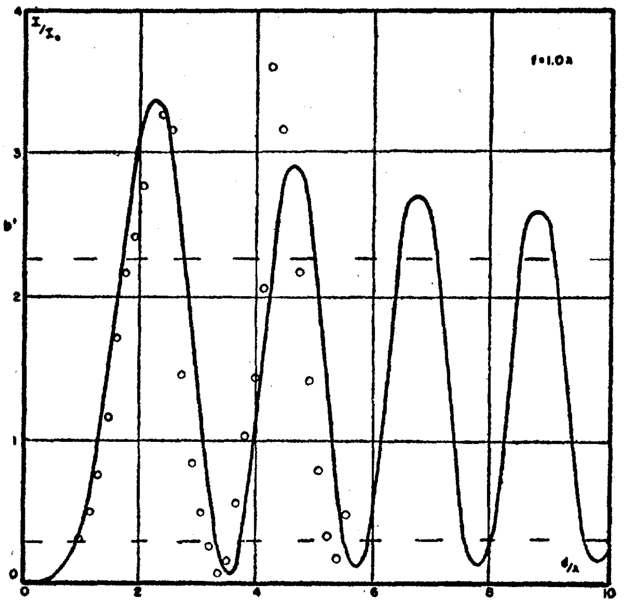
Result and Comparison
No reason why Kirchhoff integral should work here! Close distance AND small aperture size…
Yet experimental result is not far off from theory.
First, assume incident plane wave to directly compare with the result in [1].
Parameters:
Incident wave has uniform amplitude across aperture (plane wave)
Observation point is 1.0𝜆 downstream from aperture
Relative intensity computed by ratio of perturbed to unperturbed intensity at observation point.
Take 𝜆 = 2.0 cm.
Our result matches the one from [1]. But how does this make intuitive sense? Fresnel zone interference…
z = 1.0𝜆
Repeated calculation at other z values (0.5𝜆, 2.0𝜆, 5.0𝜆. Results all match theory curves in paper.
Result from [1]. Solid = theory calc., circles = experimental measurement
Our calculation

Slide 13
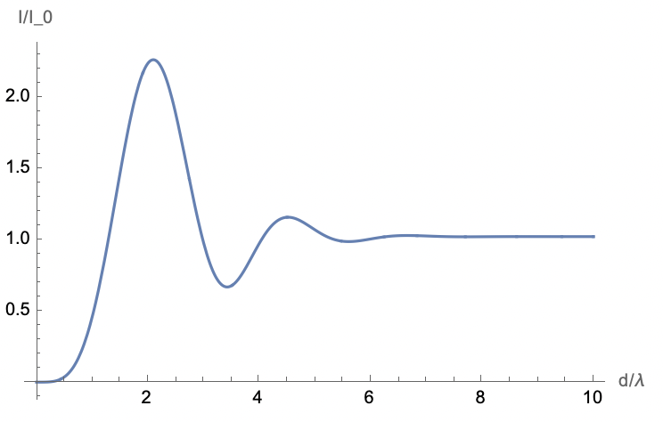
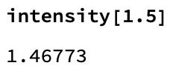
Now make incident wave at aperture a Gaussian. Hence, field across the aperture has radial Gaussian dependence.
Parameters:
Incident wave has radial Gaussian profile across aperture
Assume focus of Gaussian beam is at aperture
Observation point is 1.0𝜆 downstream from aperture
Relative intensity computed by ratio of perturbed to unperturbed intensity at observation point
We take 𝜆 = 2.0 cm and w₀ = 1.5𝜆 (must keep w₀ ≳ 1.2𝜆 for the paraxial approx. to remain valid).
Observations:
Less oscillations b/c a gaussian beam has finite transverse extent
As d/𝜆 >> w₀, I/I₀ -> 1 (expected b/c large aperture should have no effect)
For our RF MOT coil size (d/𝜆 = 1.5), theory predicts 1.47x enhancement over unperturbed value in intensity.
z = 1.0𝜆

Slide 14
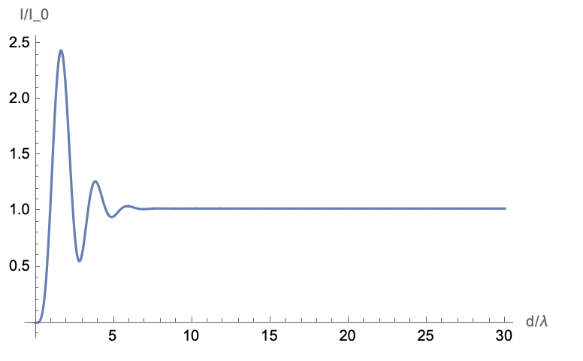
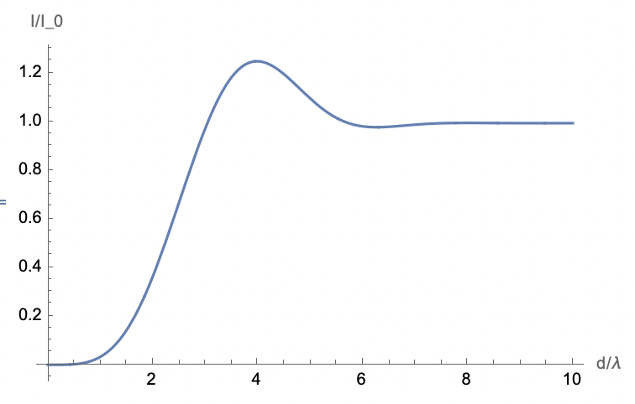
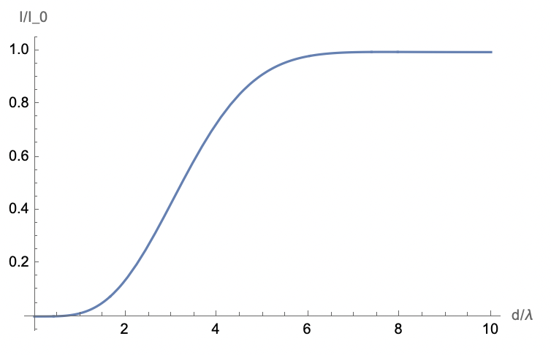
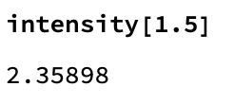
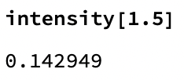
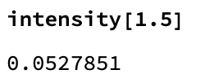
Experiment with varying z and w₀ to see how the plot changes.
1. Altering the observation point distance (but keep w₀ = 1.5𝜆):
z = 0.5𝜆
z = 5.0𝜆
z = 25.0𝜆
Observation:
As z increases, likelihood of I/I₀ > 1 for any d/𝜆 drops to zero.
In fact, once z is large enough, there can only be I/I₀ < 1 for d/𝜆 small enough for aperture to affect propagation.
As z decreases, I/I₀ maxima shift towards smaller d/𝜆
seems optimal I/I₀ for our value d/𝜆 = 1.5 occurs around z = 0.4𝜆.
unclear how much we can trust result for z ≲ 0.5𝜆… although [1] did measurements even at z=0𝜆 and 0.125𝜆.

Slide 15
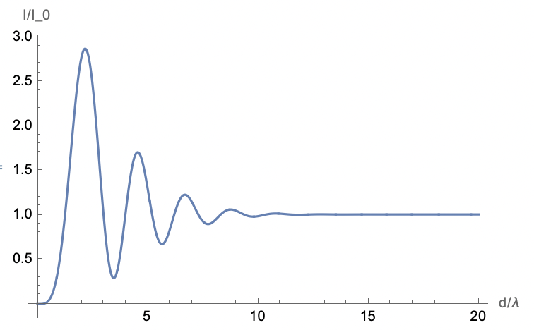
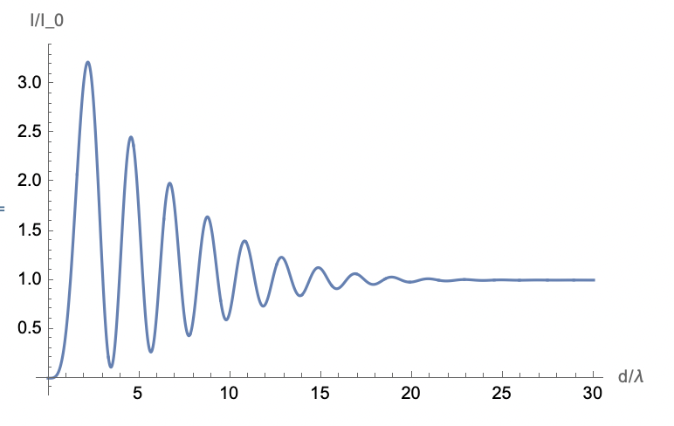
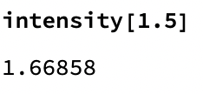
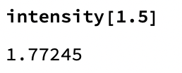
2. Altering the waist size (but keep z = 1.0𝜆):
To keep paraxial approx. valid, don’t go below w₀ = 1.5𝜆 (it also gives nonsensical results in the plot like I/I₀ ≠ 1 for d/𝜆 >> 1.)
w₀ = 2.5𝜆
w₀ = 5.0𝜆
Observation:
As w₀ increases, the behavior tends towards the plane wave limit (fringes shift towards smaller d/𝜆)
Rapid oscillations akin to “interference fringes” whose amplitude goes between I/I₀ > 1 and I/I₀ < 1.
Makes sense because for larger w₀, transverse extent becomes more like plane wave
So, in limit of w₀ → ∞, I/I₀ → 1.81.

Slide 16
Making sense of these results:
General observed trend:
Increasing observation point distance z dampens I/I₀ fringes to “logistic function” limit
Increasing waist size w₀ enhances I/I₀ fringes to “plane wave” oscillation limit
This means we want molecules to be very close to aperture and our beam waist to be as large as possible***
We also must hope we’re “lucky” with our aperture size and that we land on the right side of the “interference fringe”
Luckily for our case: if assume w₀ = 1.5𝜆, then I/I₀ = 1.47 at molecule location (z = 1.0𝜆) for our aperture size (d/𝜆 = 1.5).
z = 1.0𝜆
*** Caveat: This is not true for us once we consider power!
Send microwaves out with fixed amount of power (peak I along aperture axis ~ P/w₀²).
Larger w₀ means smaller initial peak intensity at aperture.
So, we want to find what’s the largest w₀ we can have and still maintain sufficient Rabi frequency (even w/our enhancement).
Recall we ideally want Ω ~ 100 MHz → I₀ = 4.34 W/cm².

Slide 17
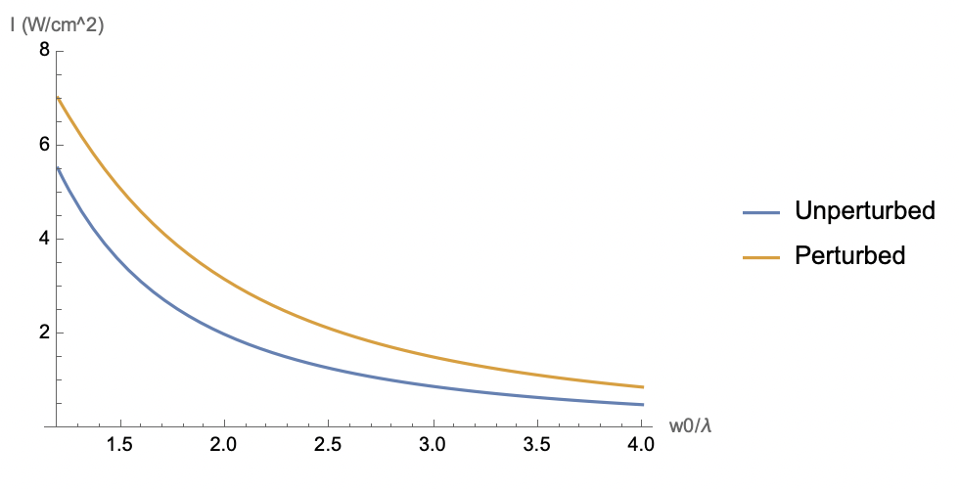
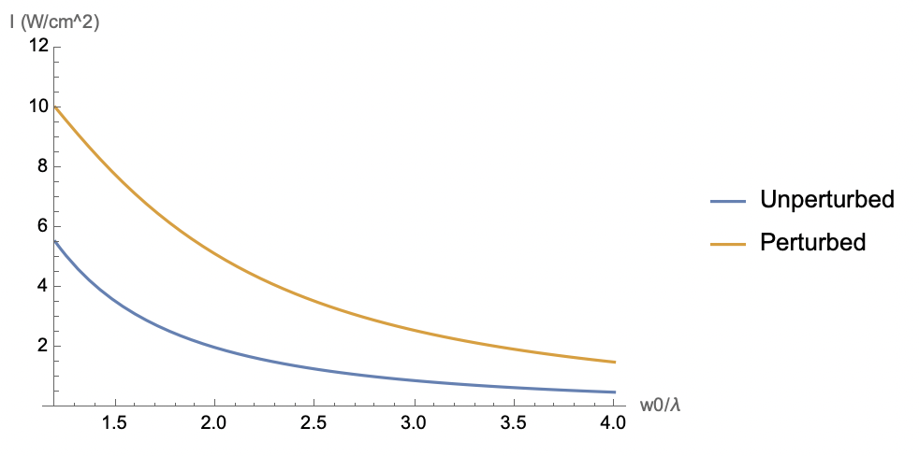
The line between enhancement and suppression…
Recall we ideally want Ω ~ 100 MHz → I₀ = 4.34 W/cm².
As always, assume beam waist is at aperture.
For P = 50 W, d/𝜆 = 1.5, z = 1.0𝜆, we find:
For P = 50 W, d/𝜆 = 2.0, z = 1.0𝜆, we find:
Unperturbed: max allowable w₀ = 1.35𝜆.
Perturbed (w/enhancement): max allowable w₀ = 1.65𝜆.
At w₀ = 1.5𝜆, intensity enhancement gives I = 3.47 W/cm² → 5.09 W/cm².
Paraxial approx. will break down for w₀ ≲ 1.2𝜆.
Unperturbed: max allowable w₀ = 1.35𝜆.
Perturbed (w/enhancement): max allowable w₀ = 2.21𝜆.
At w₀ = 1.5𝜆, intensity enhancement gives I = 3.47 W/cm² → 7.76 W/cm².

Slide 18
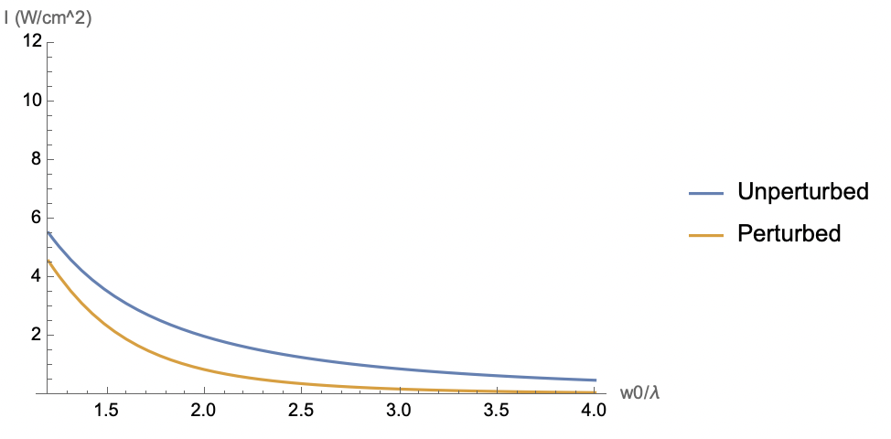
For P = 50 W, d/𝜆 = 3.5, z = 1.0𝜆, we find:
Bottom line: d/𝜆 and z both impact whether our intensity is enhanced or suppressed. Of course, increasing power would shift both “unperturbed” and “perturbed” curves up equally.
Unperturbed: max allowable w₀ = 1.35𝜆.
Perturbed (w/enhancement): max allowable w₀ = 1.22𝜆.
At w₀ = 1.5𝜆, intensity enhancement gives I = 3.47 W/cm² → 2.35 W/cm².

Slide 19
The next steps:
Finish fleshing out optimal parameters in this calculation and take as a crude benchmark of how well we can do
But we will always win the most from sending in more power…
Use HFSS software to numerically simulate our exact situation (and hence get a more realistic grip on how well we can do)
Go back to doing experimental measurements to determine intensity along the aperture axis

